Slide 1

AmongUs Assignment
-By Saadiya

Slide 2
Question No: 1.1
Read in the data using the mongoimport command.
mongoimport --db assignment --collection among_us --file /Users/saadiyasaleem/Downloads/Among_Us_data.json --jsonArray

Slide 3
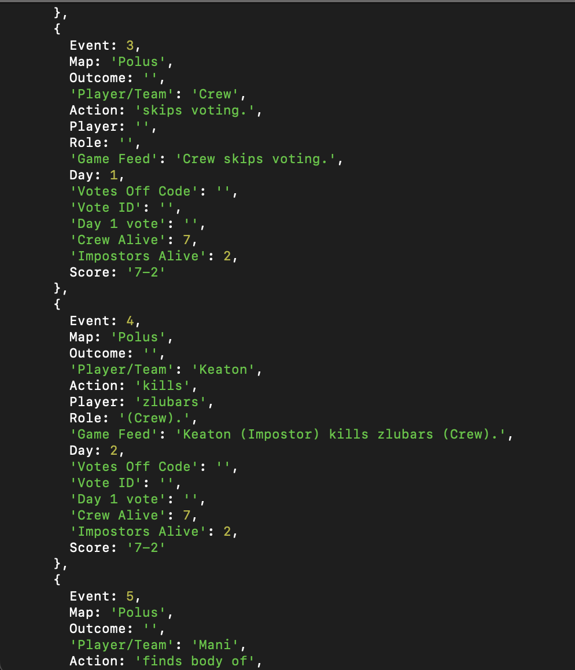
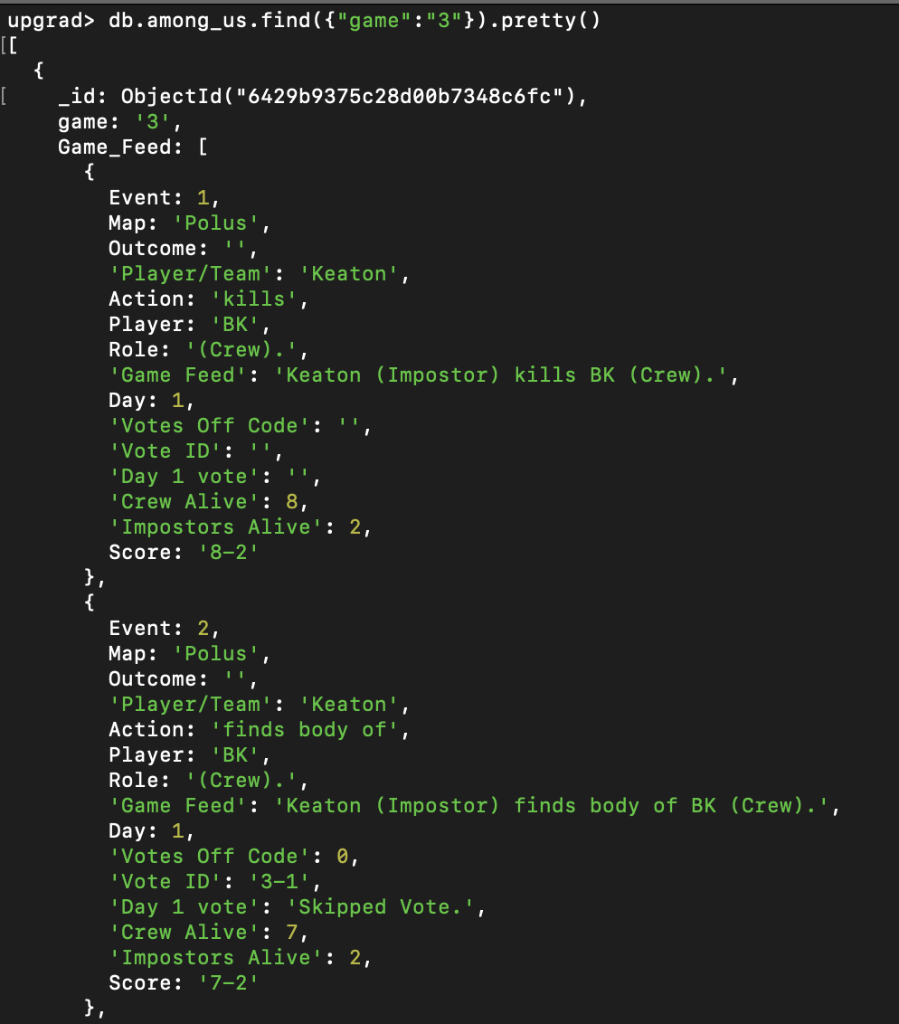
Question No: 1.2
Display data for the match with “game” = “3”
db.among_us.find({"game":"3"}).pretty()

Slide 4

Question No: 2.0
In this subtask, you are expected to create a new collection with only the document relating to game 3.
db.game3.insertMany(db.among_us.find({"game":"3"}).toArray())

Slide 5
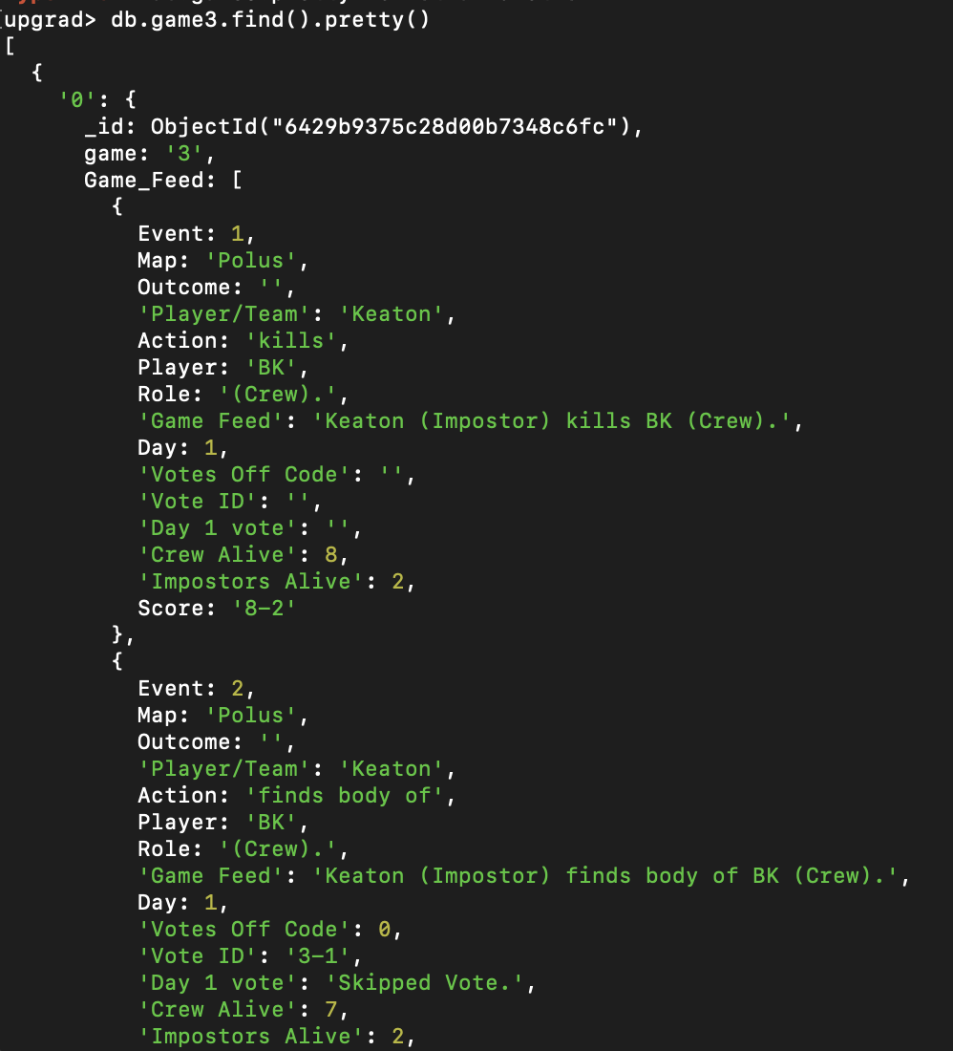
Question No: 2.1
Display the Game Feed data for the game in the new collection.
db.game3.find().pretty()

Slide 6
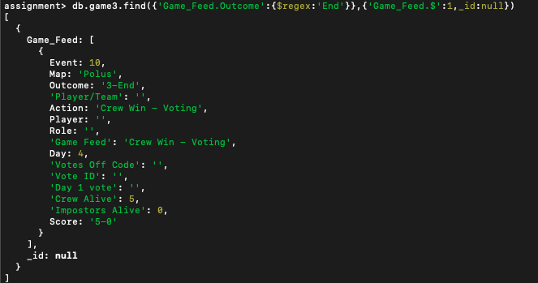
Question No: 2.2
Display the last event in game 3.
db.game3.find({'Game_Feed.Outcome':{$regex:'End'}},{'Game_Feed.$':1,_id:null})

Slide 7
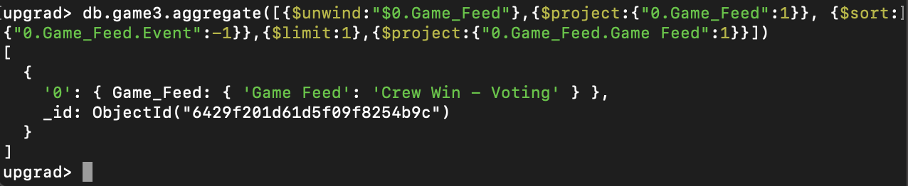
Question No: 2.3
Who won game 3, imposters or crew?
db.game3.aggregate([{$unwind:"$0.Game_Feed"},{$project:{"0.Game_Feed":1}}, {$sort:{"0.Game_Feed.Event":-1}},{$limit:1},{$project:{"0.Game_Feed.Game Feed":1}}])
Crew won game 3

Slide 8
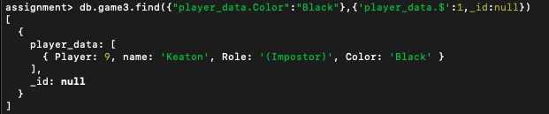
Question No: 2.4
Who picked the black colour in game 3? Was that player crew or imposter?
db.game3.find({"player_data.Color":"Black"},{'player_data.$':1,_id:null})
Keaton, an Imposter chose black color

Slide 9
Question No: 2.5
How many voting events happened in game 3?
db.game3.aggregate({$project:{cnt:{$size:'$voting_data.Vote_Event'}}})
24 voting events happened

Slide 10
Question No: 2.6
If you were to redesign this database to make it easier to query, what changes would you make to the structure?
Eliminate redundant fields in nested fields. Game feed and voting events hold similar information
Remove nested nature of the collections and make separate collections for voting data and player data and use references in the game feed data

Slide 11
Question No: 3.1
How many events in total do you have data for, in this collection (across all games)?
db.among_us.aggregate([{$project:{_id:'$game', cnt: {$size: '$Game_Feed'}}},{$group:{_id:null,total_events:{$sum:'$cnt'}}}])
5889 events in total

Slide 12
Question No: 3.2
How many matches did the crew win versus how many matches did the impostors win?
db.among_us.find({'Game_Feed.Game Feed':{$regex:’Crew Win'}}).count()
db.among_us.find({'Game_Feed.Game Feed':{$regex:'Impostor Win'}}).count()
Crew win – 323
Impostor win - 176

Slide 13
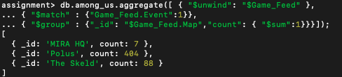
Question No: 3.3
Find out how many matches were played on each map.
db.among_us.aggregate([ { "$unwind": "$Game_Feed" },
{ "$match" : {"Game_Feed.Event":1}},{ "$group" : {"_id": "$Game_Feed.Map","count": { "$sum":1}}}]);
Polus – 404
The Skeld – 88
Mira HQ - 7

Slide 14

Question No: 3.4
How many times in total across all games did the crew skip a vote?
db.among_us.aggregate([{ "$unwind": "$Game_Feed" },
{ "$match" : {"Game_Feed.Votes Off Code":0}},{ "$group" : {"_id":null, "count": { "$sum": 1 }}}])
693 times crew skip vote

Slide 15
Question No: 3.5
How many times in total across all matches does the crew vote against imposters?
db.among_us.aggregate([{ "$unwind":"$Game_Feed"},{"$match":{"Game_Feed.Votes Off Code":2}},{ "$group" : {"_id":null, "count": { "$sum": 1 }}}])
639 times crew vote against imposter

Slide 16
Question No: 3.6
In your opinion, is the game more or less hard for impostors? Justify your answer with suitable insights from the data.
Out of 499 games, the crew won 323 times while the impostors won 176 times. So game is harder for impostors
For every 10 players, there are 2 impostors. So, impostors have to try harder to convince everyone during vote

Slide 17
Question No: 4.1
Find the number of unique players in the data set.
db.among_us.distinct("player_data.name").length
108 unique players in the dataset

Slide 18
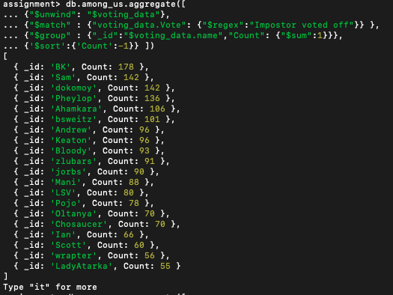
Question No: 4.2
Who is the best crew member?
db.among_us.aggregate([{"$unwind": "$voting_data"},{"$match" : {"voting_data.Vote": {"$regex":"Impostor voted off"}}},{"$group" :{"_id":"$voting_data.name","Count": {"$sum":1}}},{'$sort':{'Count':-1}} ])
[
BK is the best crew member

Slide 19
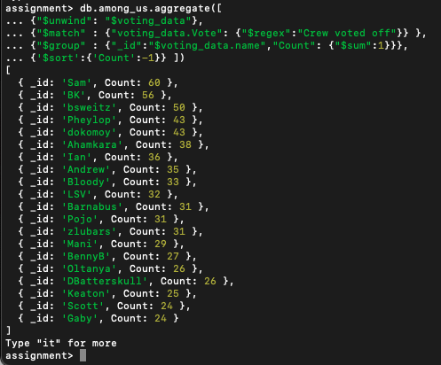
Question No: 4.3
Who is the worst crew member?
db.among_us.aggregate([
{"$unwind": "$voting_data"},{"$match" : {"voting_data.Vote": {"$regex":"Crew voted off"}} },{"$group" : {"_id":"$voting_data.name","Count": {"$sum":1}}},{'$sort':{'Count':-1}} ])
SAM is the worst crew member

Slide 20
Question No: 6
In tasks 4 and 5 you create some player-wise statistics. Explain statistics that you might want to explore (other than the ones that were calculated earlier) during the exercise of selecting players.
How many times a same player is chosen to be imposter
Which player is the best Impostor (Max win when that player was Impostor)
Which color is most popular for Crew and Impostor

Slide 21
THANK YOU

